Slide 1
VENTURE
S-Quad Round 1 Presentation
GitHub : https://github.com/ArohiJ/S-Quad-Accelathon-Project
23rd November 2020

Slide 2
Problem Statement:
There are many individuals around us that have an idea in their mind for a start-up, or he /she wants to team up with people of similar interests say for a sport, or even a rock band or wants to open a shop and requires a team to back him/her up. This part where a team is required to be built is difficult at times because we don’t always find people with the similar interest or willing to collaborate.
This project aims to connect users to people who share their interest and help them build a team for their respective domains. Be it sports, a technology start-up, a rock band or any other field that requires a team to be built the user will be able to reach out to people sharing the enthusiasm.
This also provides a platform for the other sector of people, the investors who would like to invest in budding teams.

Slide 3
Technologies Used:
Python
TKINTER (Front-end)
DBMS
Sqlite3 (Back-end)

Slide 4
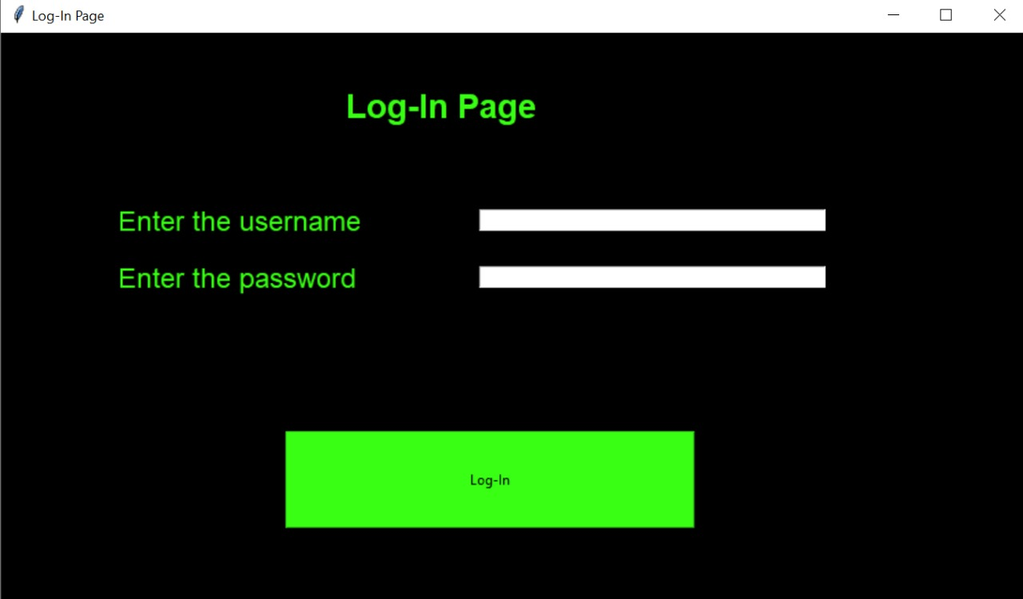
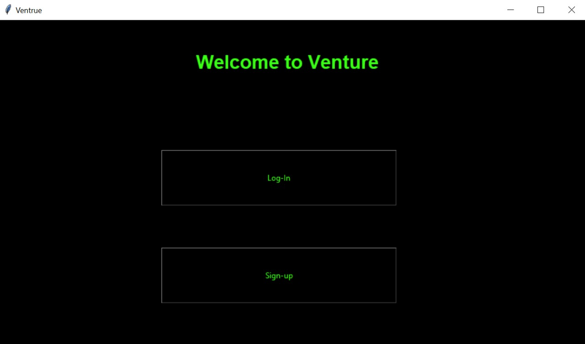
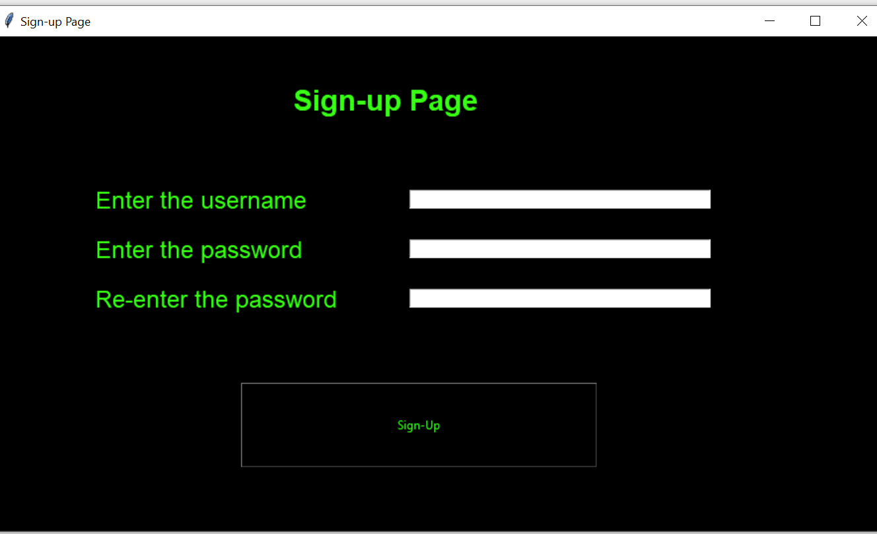
Solution

Slide 5
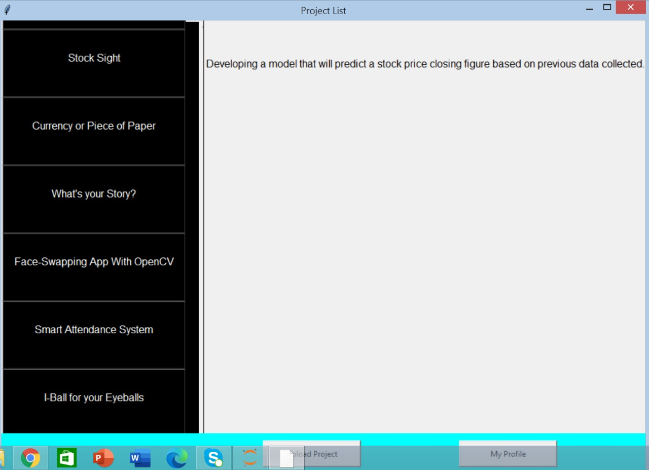
Sol
Solution
PProject List
Project Description
Navigation Bar

Slide 6
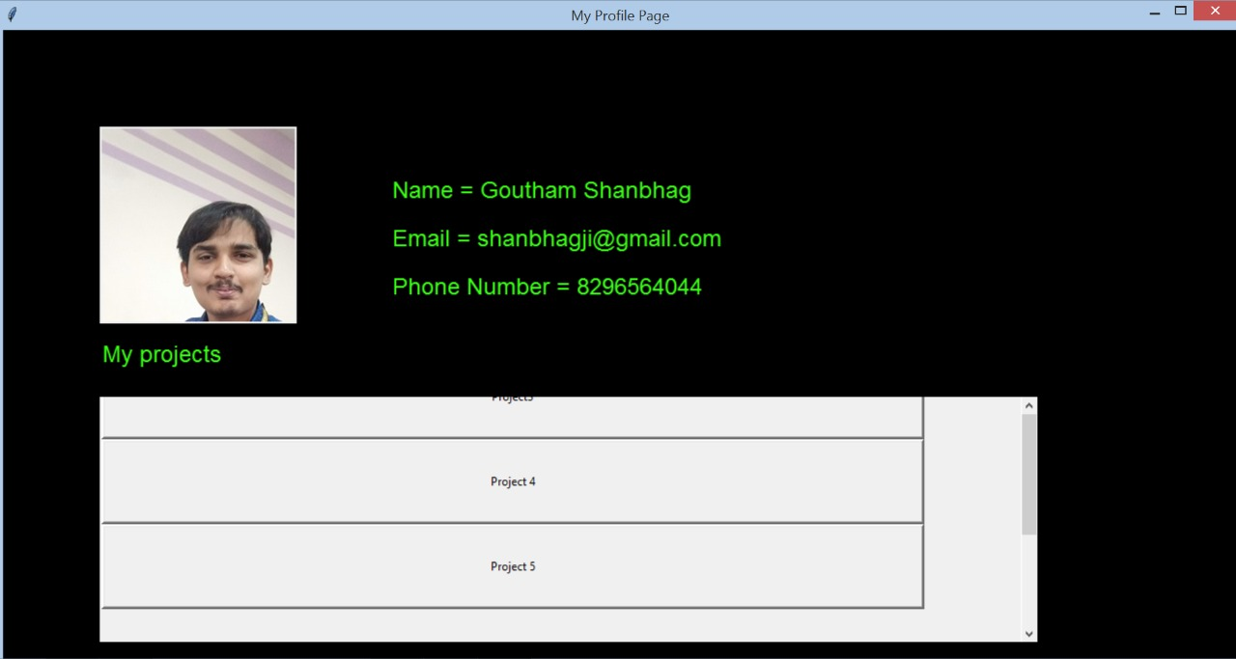
My Profile Page
My Profile Page
It’s me
User Details
User Involved Project

Slide 7
Benefits our solution will achieve :
Bridge the gap between investor and the entrepreneur.
Provide business with new insights and collaboration.
Potential clients can approach.
Provide employment opportunities.

Slide 8
Future Improvements
Improvised GUI to make the UX even better by using frameworks like ReactJS
Using a framework like Django to implement a website
Upgrading the database to enable the uploading of files and images so that the user can describe the project better
Adding a Chat Feature so users and Investors can communicate on a single platform
Better distinction between a normal user and an investor.

Slide 9
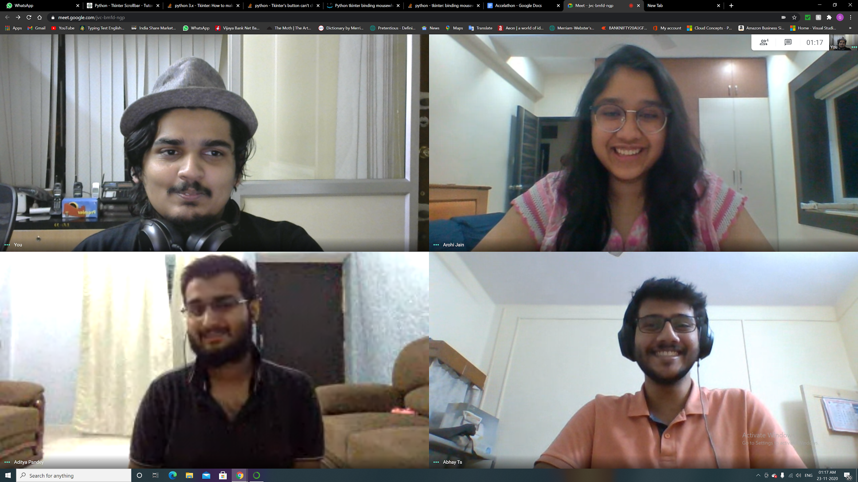
TEAM MEMBERS
AROHI JAIN
9663116677
arohi0812@gmail.com
GOUTAM SHANBHAG
8296564044
shanbhagji@gmail.com
ABHAY THOPPAL SHIVA
8105660709
abhayts14@gmail.com
ADITYA PANDEY
9721551613
adityapandey14980@gmail.com

